Slide 1
CREDIT CARD FRAUD DETECTION USING PREDICTIVE MODELLING

Slide 2
Index :
Abstract
Introduction
Problem Statement
Existing system
Disadvantages
Proposed System
Advantages
SRS

Slide 3
Abstract:-
Billions of dollars loss are caused every year due to credit card fraud transaction
To detect these fraud transaction machine learning algorithms gives the efficient way
This project deals why and how under sampling is useful in the presence of class imbalance
how to deal with unbalanced and evolving data streams
how to assess performances in a way which is relevant for detection
how to use feedbacks provided by investigators on the fraud alerts generated

Slide 4
Introduction
Credit cards are used for purchasing goods and services by using virtual card and physical card
In a physical-card based purchase, if the card was stolen then only fraud will be happened
In online payment mode, attackers need only little information for doing fraud
mainly transactions will be done through Internet or telephone
a fraudster simply needs to know the card details.
way to detect this kind of fraud is to analyze the spending patterns on every card
then figure out any inconsistency with respect to the “usual” spending patterns.
Fraud detection based on the analysis of existing purchase data of cardholder is a promising way to reduce the rate of successful credit card frauds

Slide 5
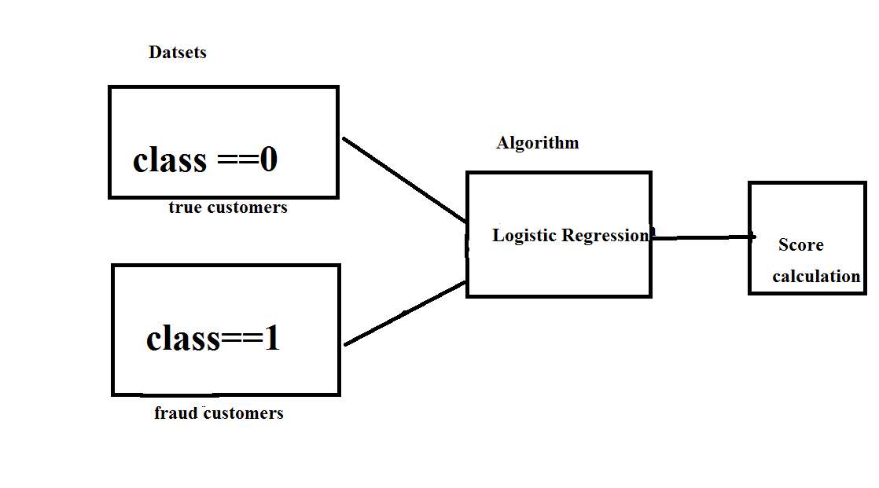
Design:

Slide 6
Problem statement
Credit card fraud stands as major problem for word wide financial institutions.
We can observe this from many financial reports (Bhattacharyya et al., 2011)
10th annual online fraud report by Cyber Source shows that estimated loss due to online fraud is $4 billion for 2008 which is 11% increase than $3.6 billion loss in 2007
In 2006, fraud in United Kingdom alone was estimated to be £535 million in 2007 and now costing around 13.9 billion a year (Mahdi et al., 2010).
From 2006 to 2008, UK alone has lost £427.0 million to £609.90 million due to credit and debit card fraud (Woolsey &Schulz, 2011).
card-not-present fraud losses are increasing at higher rate due to online transactions.
perpetrators are evolving their methods and practices to avoid detection.
Thus an effective and innovative methods need to be develop which will evolve accordingly to the need.

Slide 7
Existing system
This was on k-means Algorithm implementation
The model was set to have 2 clusters, 0 being non-fraud and 1 being fraud.
We also experimented with different values for the hyper parameters
they all produced similar results. Changing the dimensionality of the data

Slide 8
Disadvantages :
The Clustering produce the less accuracy when compared to Regression methods
Comparatively with other algorithms k-means produce less accurate scores

Slide 9
Proposed System:
dataset is gathered from Kaggle.
After initial data exploration, we knew we would implement a logistic regression model for best accuracy reports.
Logistic regression, as it was a good candidate for binary classification.
Python sklearn library was used to implement the project
pandas to data frame for class ==0 for no fraud and class==1 for fraud
matplotlib for plotting the fraud and non fraud data
train_test_split for data extraction (Split arrays or matrices into random train and test subsets)
Using Logistic Regression machine learning algorithm for fraud detection
Finally Confusion matrix was plotted on true and predicted.

Slide 10
Advantages:
The results obtained by the Logistic Regression Algorithm is best
The Accuracy obtained was almost equal to cent percent
It gives the plots after processing the data

Slide 11
Hardware Requirements:
• RAM: 4GB and Higher
• Processor: Intel i3 and above
• Hard Disk: 500GB: Minimum

Slide 12
Software Requirements:
OS: Windows or Linux
Python IDE : python 2.7.x and above
Pycharm IDE Required
Setup tools and pip to be installed for 3.6 and above
Language : Python Scripting

